Slide 1
Prediction of protein structural classes using support vector machines
X.-D. Sun and R.-B. Huang
Amino Acids, Vol. 30, pp. 469–475, 2006
Date: May. 9, 2007
Introducer: Chung-Han Chiang

Slide 2
Abstract
The support vector machine, a machine-learning method, is used to predict the four structural classes, i.e. mainly α , mainly β , α–β and fss, from the topology-level of CATH protein structure database. For the binary classification, any two structural classes which do not share any secondary structure such as and elements could be classified with as high as 90% accuracy. The accuracy, however, will decrease to less than 70% if the structural classes to be classified contain structure elements in common. Our study also shows that the dimensions of feature space 202400 (for dipeptide) and 2038 000 (for tripeptide) give nearly the same prediction accuracy. Among these 4 structural classes, multi-class classification gives an overall accuracy of about 52%, indicating that the multi-class classification technique in support of vector machines may still need to be further improved in future investigation.

Slide 3
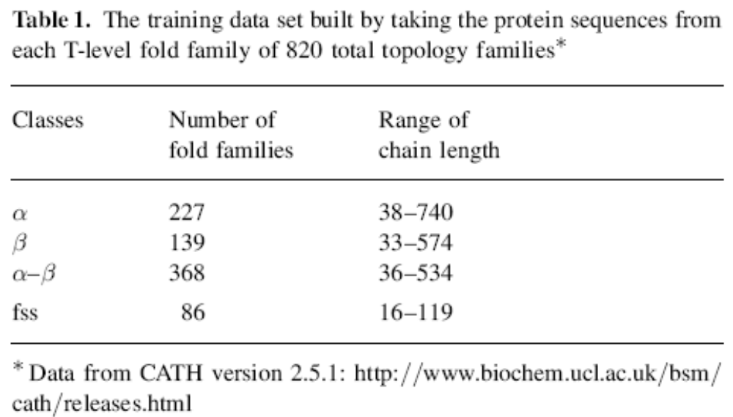
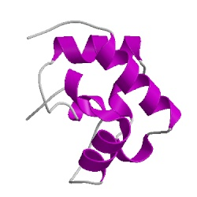
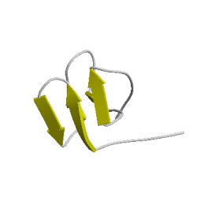
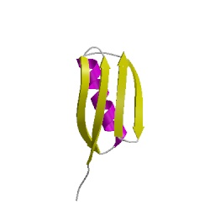
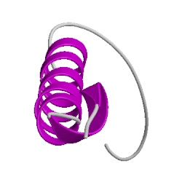
Materials and methods
Mainly - α
Mainly - β
Mixed α-β
Few Secondary Structure

Slide 4
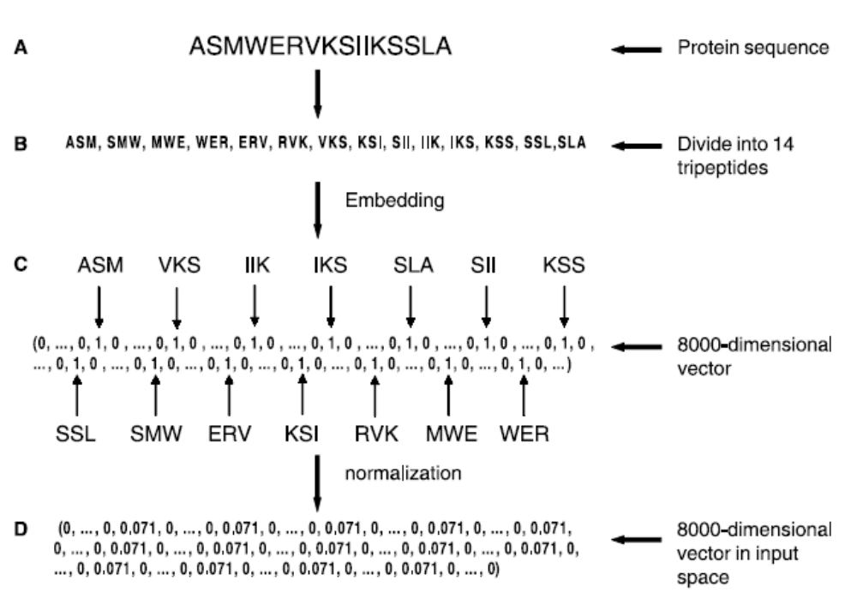
Preparation of data input before SVM processing.

Slide 5
Cross validation – LOOCV
(Leave One Out Cross – Validation)
In LOOCV, data are divided into two sets: the ‘‘training set’’ which is used to train the SVMs classifier, and the ‘‘test set’’ on which the trained classifier is tested.

Slide 6
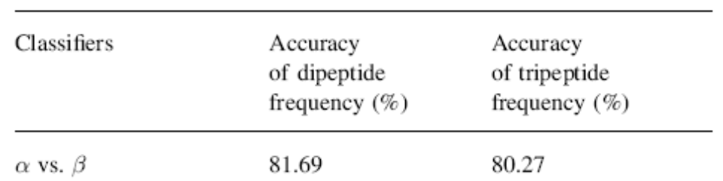
Example
(227 families )α vs. (139 families) β
Preparation of data input before SVM processing.
1．取（227+139）個 families 當作使用的data
2．任取其中一個 family 當作test set，其餘的均為training set
3．用training set作為SVM的分類器（training）
4．將取出的 family （test set）丟入分類器，判斷分類器的好壞
重複以上步驟（227+139）次
將所有得到的accuracy取平均值
得到最後的accuracy

Slide 7
Multi-class prediction methods
In this research, two multi-class classification schemes are employed: one is one-against-one classifier in which six binary classifiers are built: α vs. β , α vs. α–β, α vs. fss, β vs. α–β, β vs. fss and α–β vs. fss; another is one-against-others in which four binary classifiers are involved: α vs. others (including β , α–β and fss), β vs. others (α, α–β and fss), α–β vs. others (α, β, and fss) and fss vs. others (α, β and α–β)

Slide 8
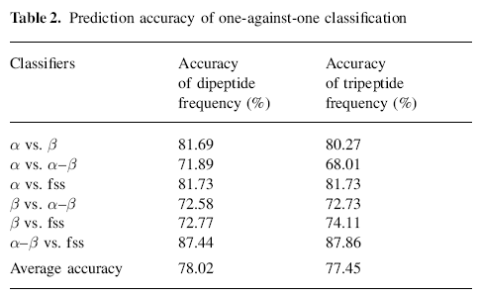
Results and discussion

Slide 9
